Slide 1
Steady State error
Dr. Enrique Aguayo-Lara

Slide 2
Steady State Error
Besides stability and Transient response, It is important to study the capacity of systems to follow some reference in closed loop.
If the output of a closed loop system is not equal to its reference, an steady state error is said to exist.

Slide 3
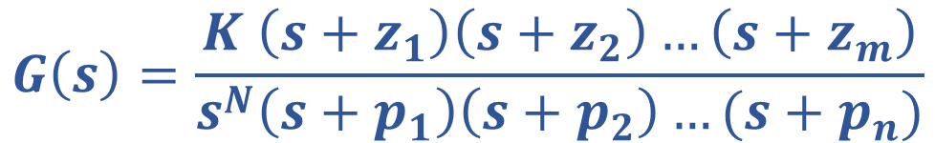
Continuous system
R(s)
Consider the previous closed loop system, with transfer function:
The term in the denominator is a pole in s=0 with multiplicity N.
$$G\left(s\right)=\frac{K \left(s+z_{1}\right)\left(s+z_{2}\right)…\left(s+z_{m}\right)}{s^{N}\left(s+p_{1}\right)\left(s+p_{2}\right)…(s+p_{n})}$$

Slide 4
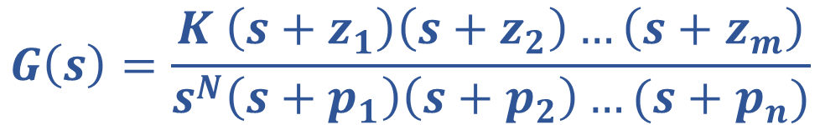
Type of a system
In the previous transfer function, the value of N determines the Type of the system.
$$G\left(s\right)=\frac{K \left(s+z_{1}\right)\left(s+z_{2}\right)…\left(s+z_{m}\right)}{s^{N}\left(s+p_{1}\right)\left(s+p_{2}\right)…(s+p_{n})}$$

Slide 5
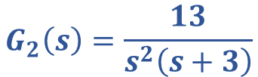
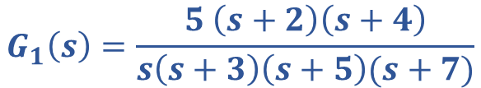


Type of a system
$$G_{1}\left(s\right)=\frac{5 \left(s+2\right)\left(s+4\right)}{s\left(s+3\right)\left(s+5\right)(s+7)}$$
Type 1
4th order
$$G_{2}\left(s\right)=\frac{13}{s^{2}\left(s+3\right)}$$
Type 2
3rd order
$$G_{3}\left(s\right)=\frac{5 s}{{4s}^{2}+5s+1}$$
Type 0
2nd order
$$G_{4}\left(s\right)=\frac{5 s+2}{{{7s}^{3}+4s}^{2}+5s}$$
Type 1
3rd order

Slide 6
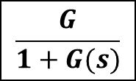
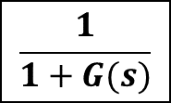
Variable of interest: ERROR
R(s)
R(s)
Y(s)
$$\frac{G}{1+G(s)}$$
R(s)
1
E(s)
R(s)
E(s)
$$\frac{1}{1+G(s)}$$
G(s)
Y(s)

Slide 7

Error transfer function
The transfer function of the error and the reference is then:
Where the error e(t)=r(t)-y(t)
$$\frac{E(s)}{R(s)}=\frac{1}{1+G(s)}$$

Slide 8

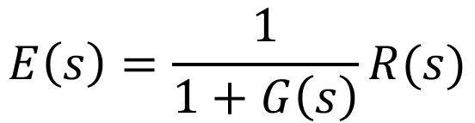
Error prediction
Using the final value theorem (for stable systems of course!)
Then, the steady state error is:
$$\frac{E(s)}{R(s)}=\frac{1}{1+G(s)}$$
$$E\left(s\right)=\frac{1}{1+G\left(s\right)}R(s)$$
$e_{ss}=\lim_{t→∞}{e\left(t\right)=\lim_{s→0} sE\left(s\right)=}$ $\lim_{s→0} s\frac{1}{1+G\left(s\right)}R(s)$

Slide 9
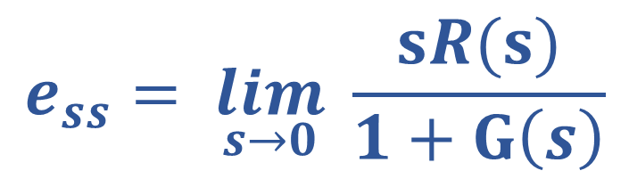
Error prediction
The steady state error is given by
$$e_{ss}= \lim_{s→0} \frac{sR(s)}{1+G\left(s\right)}$$

Slide 10
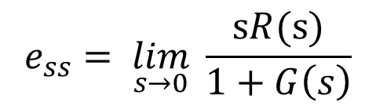

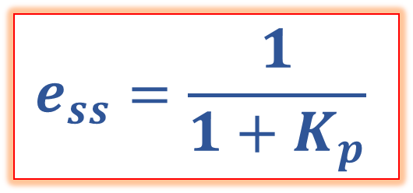
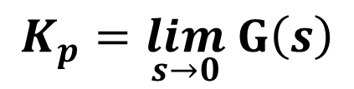
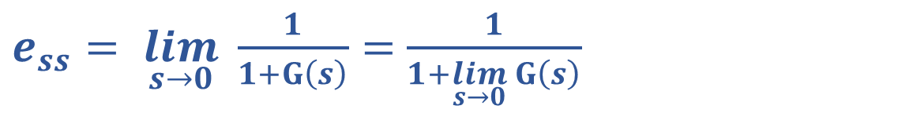
Constant reference
$$e_{ss}= \lim_{s→0} \frac{sR(s)}{1+G\left(s\right)}$$
Reference: Unit step
$$e_{ss}= \lim_{s→0} \frac{s \left(\frac{1}{s}\right)}{1+G\left(s\right)}$$
$$e_{ss}=\frac{1}{1+K_{p}}$$
$e_{ss}= \lim_{s→0} \frac{1}{1+G\left(s\right)}=$ $\frac{1}{1+\lim_{s→0} G\left(s\right)}$
$$K_{p}=\lim_{s→0} G\left(s\right)$$
When can the steady state error be equal to zero?
Position error constant

Slide 11
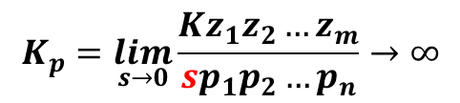

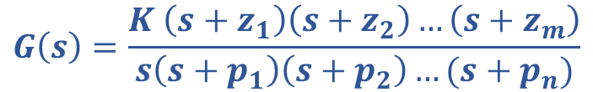



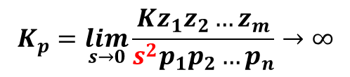
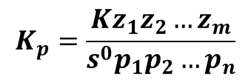
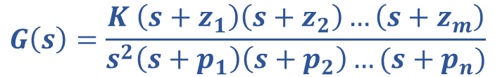
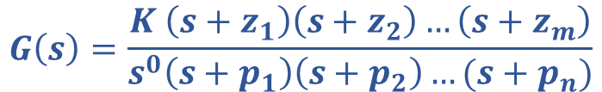

Constant reference
$$e_{ss}=\frac{1}{1+K_{p}}$$
Reference: Unit step
Type 0
Type 1
Type 2
$$K_{p}=\lim_{s→0} G\left(s\right)$$
$$G\left(s\right)=\frac{K \left(s+z_{1}\right)\left(s+z_{2}\right)…\left(s+z_{m}\right)}{s^{0}\left(s+p_{1}\right)\left(s+p_{2}\right)…(s+p_{n})}$$
$$K_{p}=\frac{Kz_{1}z_{2}…z_{m}}{s^{0}p_{1}p_{2}…p_{n}}$$
$$e_{ss}=\frac{1}{1+K_{p}}$$
$$G\left(s\right)=\frac{K \left(s+z_{1}\right)\left(s+z_{2}\right)…\left(s+z_{m}\right)}{s\left(s+p_{1}\right)\left(s+p_{2}\right)…(s+p_{n})}$$
$$K_{p}=\lim_{s→0}\frac{Kz_{1}z_{2}…z_{m}}{sp_{1}p_{2}…p_{n}}→∞$$
$$e_{ss}=0$$
$$G\left(s\right)=\frac{K \left(s+z_{1}\right)\left(s+z_{2}\right)…\left(s+z_{m}\right)}{s^{2}\left(s+p_{1}\right)\left(s+p_{2}\right)…(s+p_{n})}$$
$$K_{p}=\lim_{s→0}\frac{Kz_{1}z_{2}…z_{m}}{s^{2}p_{1}p_{2}…p_{n}}→∞$$
$$e_{ss}=0$$

Slide 12

Constant reference
$$e_{ss}=\frac{1}{1+K_{p}}$$
Reference: Unit step
For stable systems in closed loop:
Type 0 → Constant error
Type 1 or greater → 0 error
$$K_{p}=\lim_{s→0} G\left(s\right)$$
$$e_{ss}=\frac{1}{1+K_{p}}$$

Slide 13
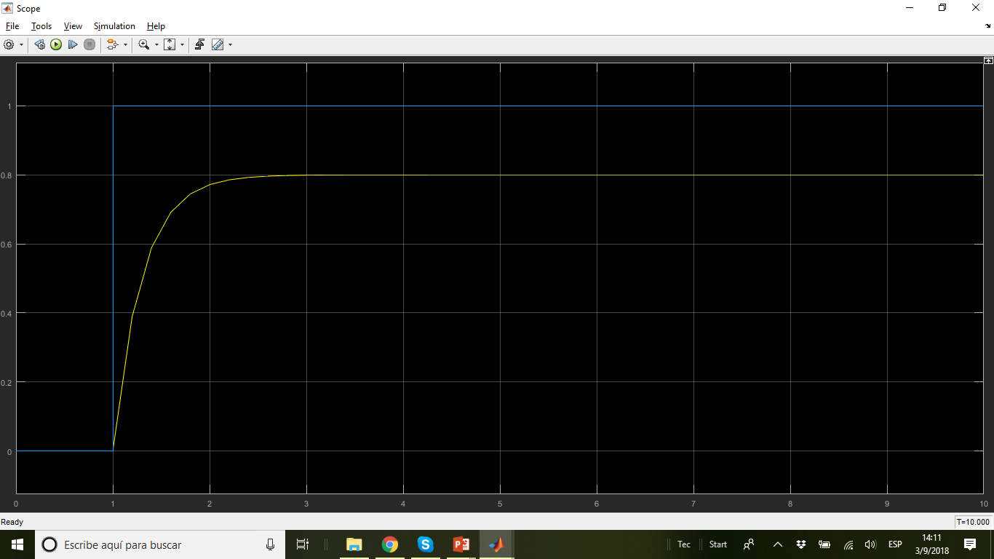
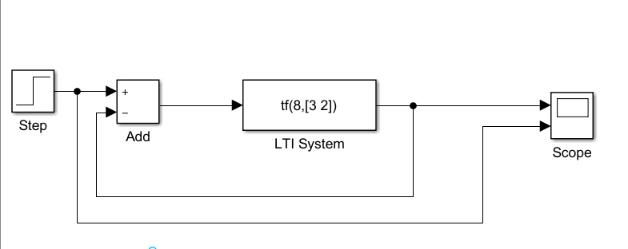
Constant Reference

Slide 14
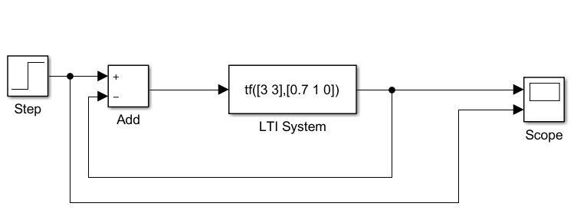

Constant Reference

Slide 15
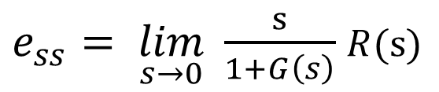
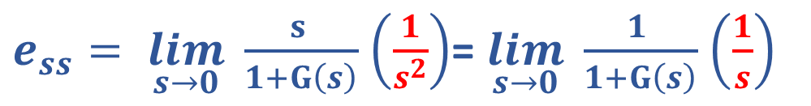
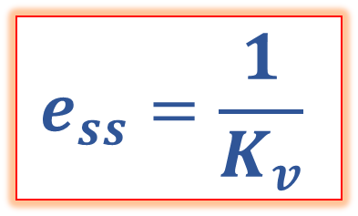
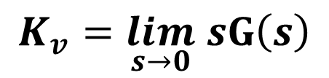
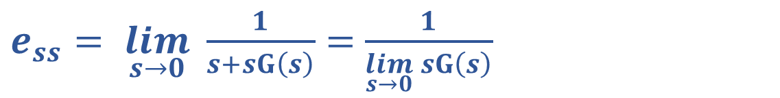
Ramp reference
$e_{ss}= \lim_{s→0} \frac{s}{1+G\left(s\right)}$ $R(s)$
Reference: Unit ramp
$e_{ss}= \lim_{s→0} \frac{s }{1+G\left(s\right)}$ $\left(\frac{1}{s^{2}}\right)$= $\lim_{s→0} \frac{1 }{1+G\left(s\right)}$ $\left(\frac{1}{s}\right)$
$$e_{ss}=\frac{1}{K_{v}}$$
$e_{ss}= \lim_{s→0} \frac{1}{s+sG\left(s\right)}=$ $\frac{1}{\lim_{s→0} sG\left(s\right)}$
$$K_{v}=\lim_{s→0} sG\left(s\right)$$
When can the steady state error be equal to zero?
Velocity error constant

Slide 16
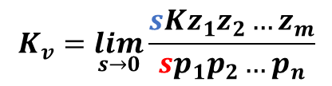

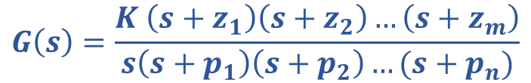



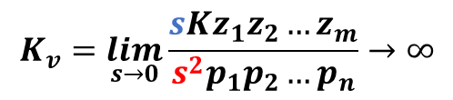



Ramp reference
$$e_{ss}=\frac{1}{K_{v}}$$
Reference: Unit ramp
Type 0
Type 1
Type 2
$$K_{v}=\lim_{s→0} sG\left(s\right)$$
$$G\left(s\right)=\frac{K \left(s+z_{1}\right)\left(s+z_{2}\right)…\left(s+z_{m}\right)}{s^{0}\left(s+p_{1}\right)\left(s+p_{2}\right)…(s+p_{n})}$$
$K_{v}=\lim_{s→0}\frac{sKz_{1}z_{2}…z_{m}}{s^{0}p_{1}p_{2}…p_{n}}$=0
$$e_{ss}=∞$$
$$G\left(s\right)=\frac{K \left(s+z_{1}\right)\left(s+z_{2}\right)…\left(s+z_{m}\right)}{s\left(s+p_{1}\right)\left(s+p_{2}\right)…(s+p_{n})}$$
$$K_{v}=\lim_{s→0}\frac{sKz_{1}z_{2}…z_{m}}{sp_{1}p_{2}…p_{n}}$$
$$e_{ss}=\frac{1}{K_{v}}$$
$$G\left(s\right)=\frac{K \left(s+z_{1}\right)\left(s+z_{2}\right)…\left(s+z_{m}\right)}{s^{2}\left(s+p_{1}\right)\left(s+p_{2}\right)…(s+p_{n})}$$
$$K_{v}=\lim_{s→0}\frac{sKz_{1}z_{2}…z_{m}}{s^{2}p_{1}p_{2}…p_{n}}→∞$$
$$e_{ss}=0$$

Slide 17



Ramp reference
$$e_{ss}=\frac{1}{K_{v}}$$
Reference: Unit ramp
For stable systems in closed loop:
Type 0 → Infinite error
Type 1 → constant error
Type 2 or greater → 0 error
$$K_{v}=\lim_{s→0} s G\left(s\right)$$
$$e_{ss}=\frac{1}{K_{v}}$$

Slide 18
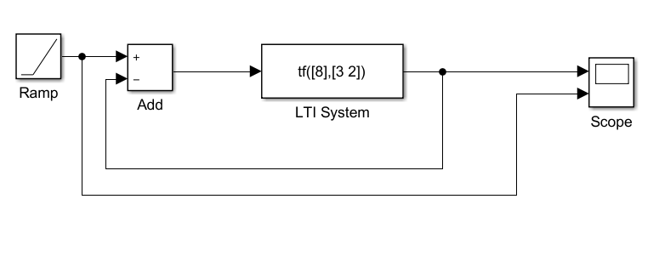
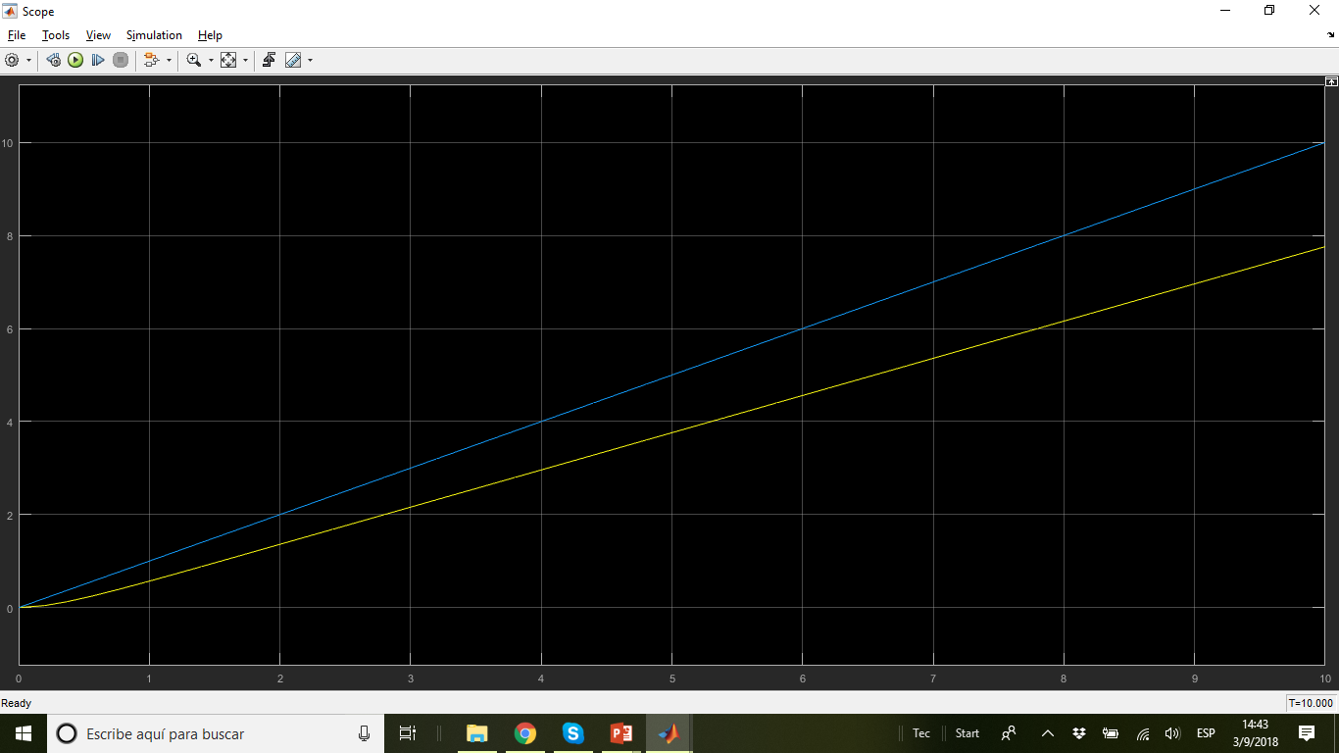
Ramp reference

Slide 19
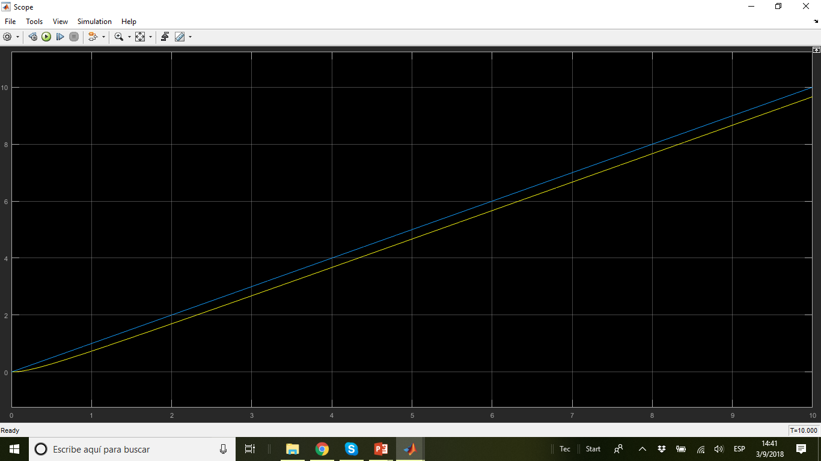
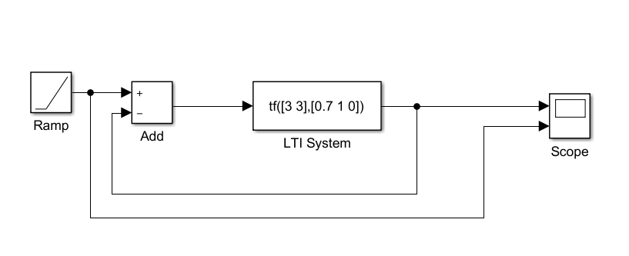
Ramp reference

Slide 20
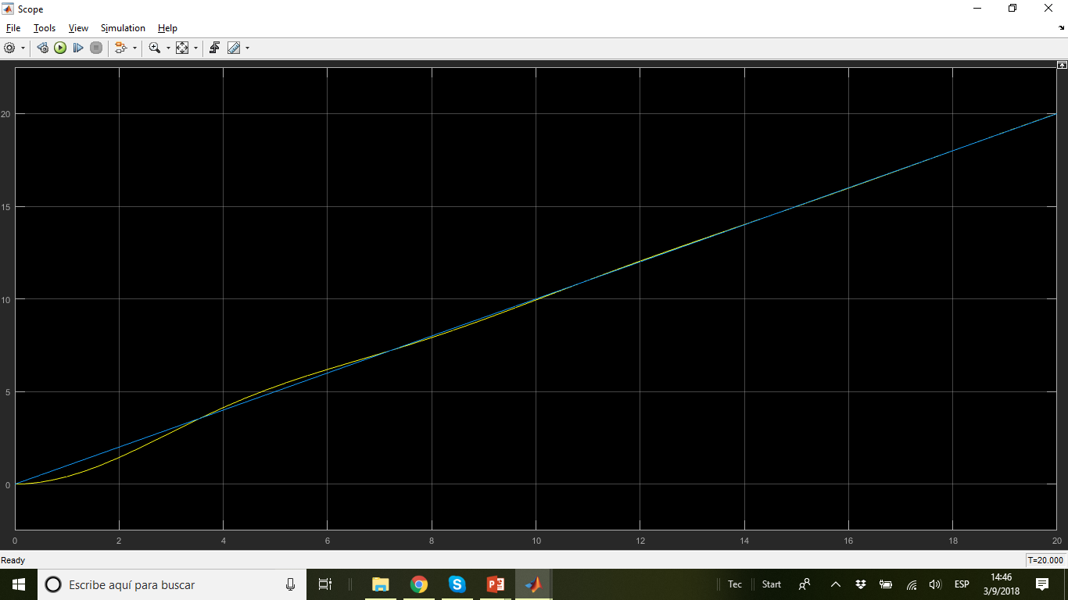

Ramp reference

Slide 21

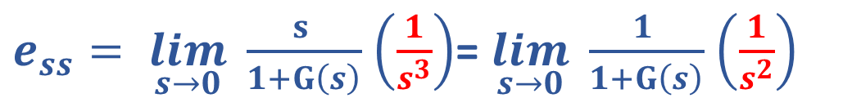
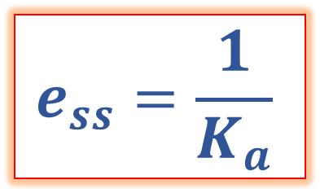
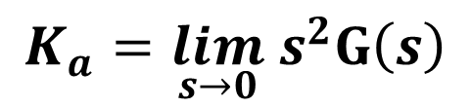
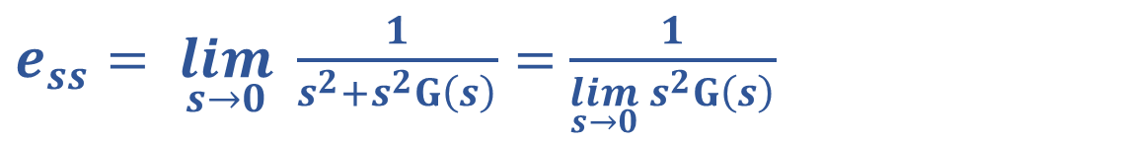
Parabolic reference
$$r(t)=\frac{t^{2}}{2}$$
$e_{ss}= \lim_{s→0} \frac{s}{1+G\left(s\right)}$ $R(s)$
Reference:
$e_{ss}= \lim_{s→0} \frac{s }{1+G\left(s\right)}$ $\left(\frac{1}{s^{3}}\right)$= $\lim_{s→0} \frac{1 }{1+G\left(s\right)}$ $\left(\frac{1}{s^{2}}\right)$
$$e_{ss}=\frac{1}{K_{a}}$$
$e_{ss}= \lim_{s→0} \frac{1}{s^{2}+s^{2}G\left(s\right)}=$ $\frac{1}{\lim_{s→0}{ s}^{2}G\left(s\right)}$
$$K_{a}=\lim_{s→0}{ s}^{2}G\left(s\right)$$
When can the steady state error be equal to zero?
Acceleration error constant

Slide 22
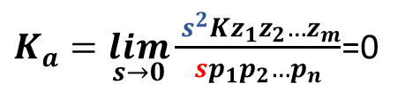






Parabolic reference
$$r(t)=\frac{t^{2}}{2}$$
$$e_{ss}=\frac{1}{K_{a}}$$
Reference:
Type 0
Type 1
$$K_{a}=\lim_{s→0}{ s}^{2}G\left(s\right)$$
$$G\left(s\right)=\frac{K \left(s+z_{1}\right)\left(s+z_{2}\right)…\left(s+z_{m}\right)}{s^{0}\left(s+p_{1}\right)\left(s+p_{2}\right)…(s+p_{n})}$$
$K_{a}=\lim_{s→0}\frac{{ s}^{2}Kz_{1}z_{2}…z_{m}}{s^{0}p_{1}p_{2}…p_{n}}$=0
$$e_{ss}=∞$$
$$G\left(s\right)=\frac{K \left(s+z_{1}\right)\left(s+z_{2}\right)…\left(s+z_{m}\right)}{s\left(s+p_{1}\right)\left(s+p_{2}\right)…(s+p_{n})}$$
$K_{a}=\lim_{s→0}\frac{{ s}^{2}Kz_{1}z_{2}…z_{m}}{sp_{1}p_{2}…p_{n}}$=0
$$e_{ss}=∞$$

Slide 23






Parabolic reference
$$r(t)=\frac{t^{2}}{2}$$
$$e_{ss}=\frac{1}{K_{a}}$$
Reference:
Type 2
Type 3
$$K_{a}=\lim_{s→0}{ s}^{2}G\left(s\right)$$
$$G\left(s\right)=\frac{K \left(s+z_{1}\right)\left(s+z_{2}\right)…\left(s+z_{m}\right)}{s^{2}\left(s+p_{1}\right)\left(s+p_{2}\right)…(s+p_{n})}$$
$$K_{a}=\lim_{s→0}\frac{{ s}^{2}Kz_{1}z_{2}…z_{m}}{s^{2}p_{1}p_{2}…p_{n}}$$
$$e_{ss}=\frac{1}{K_{a}}$$
$$G\left(s\right)=\frac{K \left(s+z_{1}\right)\left(s+z_{2}\right)…\left(s+z_{m}\right)}{s^{3}\left(s+p_{1}\right)\left(s+p_{2}\right)…(s+p_{n})}$$
$K_{a}=\lim_{s→0}\frac{{ s}^{2}Kz_{1}z_{2}…z_{m}}{s^{3}p_{1}p_{2}…p_{n}}$= $∞$
$$e_{ss}=0$$

Slide 24


Parabolic reference
$$r(t)=\frac{t^{2}}{2}$$
$$e_{ss}=\frac{1}{K_{a}}$$
Reference:
For stable systems in closed loop:
Type 0 and Type 1 → Infinite error
Type 2 → constant error
Type 3 or greater → 0 error
$$K_{a}=\lim_{s→0}{ s}^{2}G\left(s\right)$$
$$e_{ss}=\frac{1}{K_{a}}$$

Slide 25


Parabolic reference

Slide 26



Parabolic reference

Slide 27



Parabolic reference

Slide 28

Parabolic reference

Slide 29







Steady State Error
Type 0 |  | $e_{ss}$=∞ | $e_{ss}$=∞
Type 1 | 0 |  | $e_{ss}$=∞
Type 2 | 0 | 0
Type 3 | 0 | 0 | 0
$$r\left(t\right)=\frac{t^{2}}{2}$$
$$r\left(t\right)=1$$
$$r\left(t\right)=t$$
$$e_{ss}=\frac{1}{1+K_{p}}$$
$$e_{ss}=\frac{1}{K_{v}}$$
$$e_{ss}=\frac{1}{K_{a}}$$

